Slide 1
WELCOME
CONFIGURATION
TO
ENTERPRISE STRUCTURE (FI)
Compiled By S.N.HEGDE

Slide 2
Topics
FI Organization
Chart of Accounts
Company Code Configuration
Business Area & Functional Area
Validation & Substitution
Sales Tax & Use Tax

Slide 3
FI ORGANIZATION
CHART

Slide 4
Preface.
Preface
All Business Processes of other modules result in financial
Implications. You must remember that almost everything else that other modules do, affects FI/CO, and sometimes they don’t know it. Thus FI / CO is the base of all other SAP applications. It takes inputs from other modules and generates MIS & External Reports

Slide 5
Preface.
Preface
Hence Enterprise Structure is the key building block to your organization. It is very important to carefully analyze your organization before setting up the FI enterprise structure. Before configuring any part of the FI structure, it is vital to have already drawn out structure which comprises chart of account, fiscal year company code, business areas, functional areas etc.

Slide 6
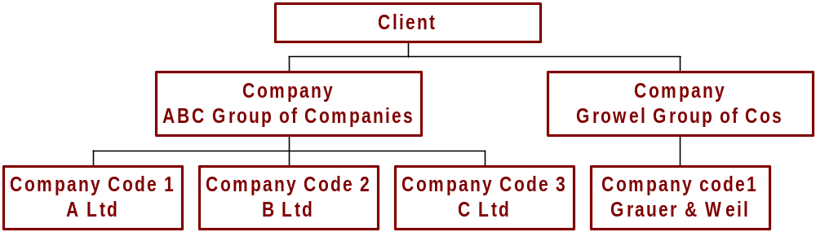
FI – Organizational Chart
FI - Organizational Chart
(A Graphical Representation )
Business Area 1
Business Area 2
Business Area 3

Slide 7
FI - Organizational Chart
Client :
It is a self contained unit in R/3 system, with separate master records and its own set of tables
Thus Client is a logical system or a self contained technical entity.
Company :
It is a unit that represents a Business Organization according to
requirements of commercial laws.
It may be a single legal entity or group of several legal entities.
Consolidation in SAP is based on COMPANY.

Slide 8
B) CHART OF ACCOUNTS

Slide 11
Charts of Accounts
INT
CAUS
GKR
1000
10000
1000
... and as many additional charts as needed!
2000
20000
2000
Notes:
Each general ledger is set up according to a chart of accounts. The chart of accounts contains the definitions of all G/L accounts in an ordered form. The definitions consist mainly of the account number, account name, and the type of G/L account, that is, whether the account is a P&L type account or a balance sheet type account.
You can define an unlimited number of charts of accounts in the R/3 System. Many country-specific charts of accounts are included in the standard system.

Slide 14
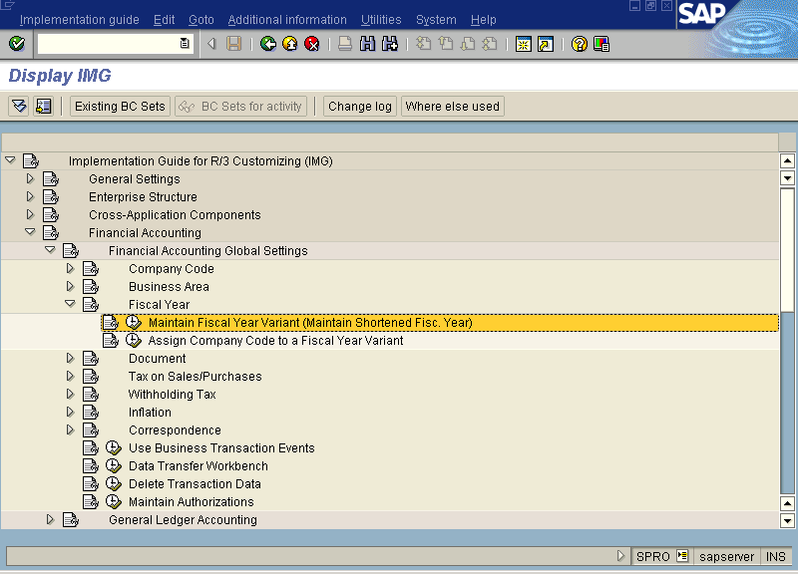

Slide 15
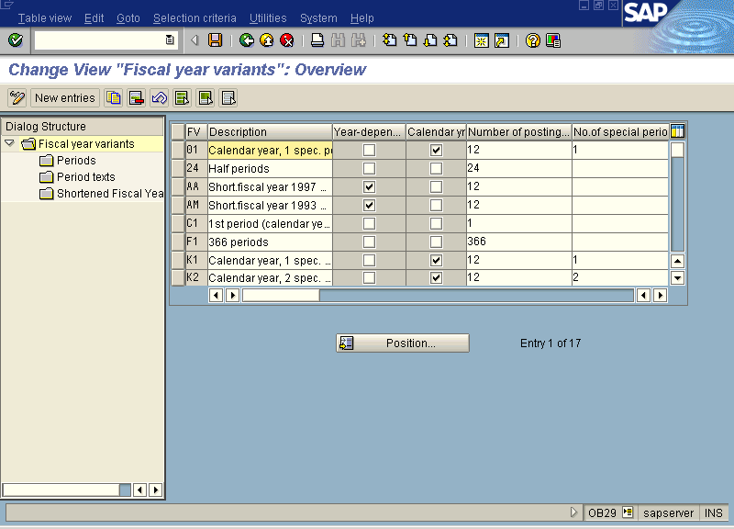

Slide 18
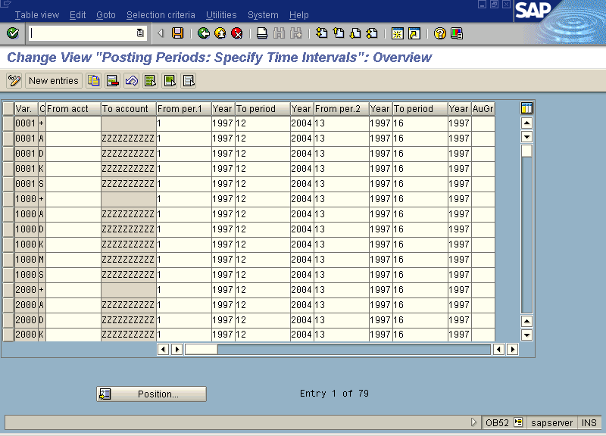

Slide 19
C) COMPANY CODE
CONFIGURATION

Slide 21
Company Code
Independent accounting entity
Company code
=
Notes:
A company code is an independent accounting entity (the smallest organizational element for which a complete self-contained set of accounts can be drawn up). An example is a company within a corporate group. It has a unique, four character key.
The general ledger is kept at the company code level and is used to create the legally required balance sheets and profit and loss statements.
A company code designation is required for every financially based transaction entered into R/3. This is done either manually or automatically by deriving the company code from other data elements.

Slide 24
- Operating COA (Chart of Account)
- Group COA
- Country COA
These types of COA can be maintained.
One COA can be assigned to multiple company codes. But one company code can have only single COA (operating).

Slide 25
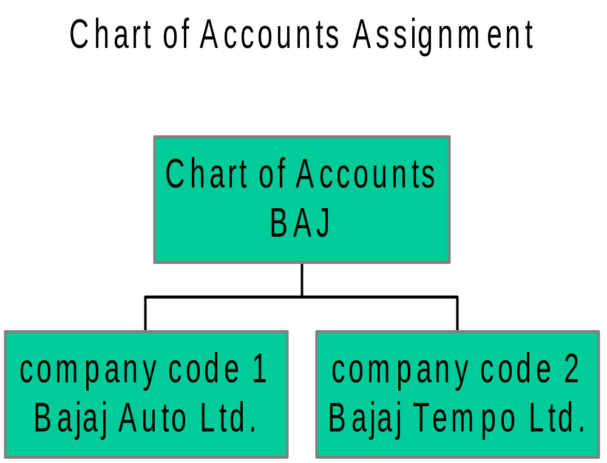

Slide 26
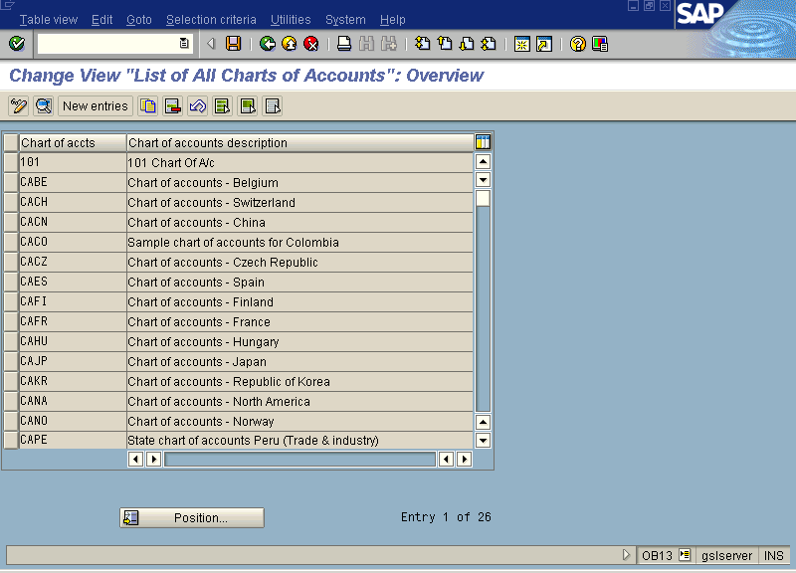

Slide 27
D) BUSINESS AREA
& FUNCTIONAL AREA

Slide 31



Business Area
Divisions
Business areas
Textile
Machinery
1033
TMD
=
Cooling
Appliances
1011
CABD
Machine
Handling
1032
MHBD
Notes:
The business segments or branches in which a group operates can be set up in the R/3 System as business areas. They provide an additional evaluation level for the purpose of segment reporting, for example.

Slide 32
Organizational Structure of Growel Group
Client
Company Code
Company
Growel Group of Companies
Company
Growel Softech Ltd.
Grauer & Weil (I) Ltd
Digikore Studios Ltd
Vapi
Plant
Pune
Plant
Kandiwali
Plant
Barotiwala
Plant
Business Area

Slide 33
FI – Organizational Chart
FI - Organizational Chart
(A Graphical Representation )
Business Area 1
Business Area 2
Business Area 3

Slide 36
Chart of Accounts Assignment
Chart of
Accounts
1000
Company code 1000
Company code 7100
Company code 7200
Notes:
For each company code, you have to specify one chart of accounts for the general ledger. This chart of accounts is assigned to the company code. A chart of accounts can be used by multiple company codes (see diagram). This means that the general ledgers of these company codes have the identical structure.

Slide 37
Company Code Specific Settings
Account definition
in chart of accounts
Account X
PLUS
PLUS
Company code
specific settings
Company code
specific settings
CC 1000
CC 7100
Account X in company code 1000
Account X in company code 7100
Notes:
Before you can use an account in a company code, you have to maintain the account definition at the chart of accounts level. You then create company code-specific settings, which are only valid in the company code. An example of a company code-specific setting is defining the account currency. Most of the accounts in company code 1000 use the UNI currency, whereas company code 3000 uses USD for most of its accounts.

Slide 38
E) VALIDATION
& SUBSTITUTION

Slide 43
F) SALES TAX & USE TAX

Slide 50
Exercises
Create Chart of Accounts
Create Fiscal Year Variant
Create Posting Period Variant
Create Credit Control Area
Create Company Code
Assign Company Code to a Chart of Accounts
Assign Company Code to Fiscal Year Variant
Create Business Areas
Create Functional Areas
Assign Company Code to Credit Control Area
Assign permitted Credit Control Areas to Company Code
Determine Tax Version

